Slide 1
Visibility
Larman, Chapter 19
(with ideas from George Blank of NJIT)
CSE432
Object Oriented Software Engineering

Slide 2
What is visibility?
Visibility is the ability of one object to “see” or have reference to another
To send a message from one object to another, the receiver object must be “visible” to the sender, via a reference

Slide 3
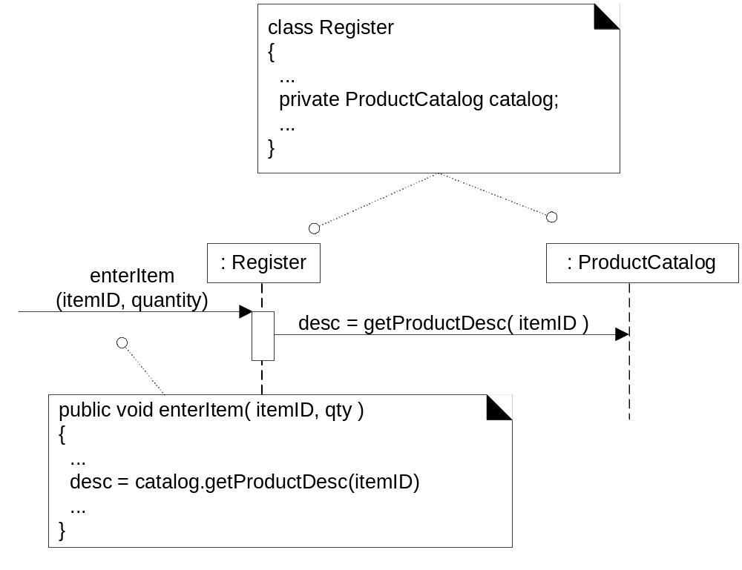
What does the getProductDesc message imply about object visibility?
Fig. 19.1

Slide 4
Four Kinds of Visibility
OO programming languages may provide four levels of scope for names:
Attribute visibility
Parameter visibility
Local visibility
Global visibility

Slide 5
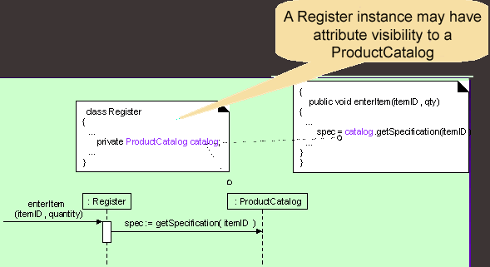
Attribute Visibility
Fig. 19.2

Slide 6
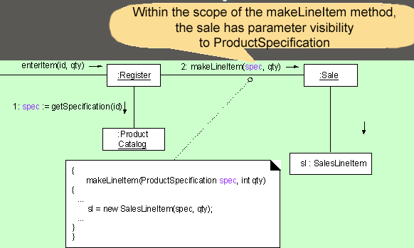
Parameter Visibility
Fig. 19.3
Why is transforming parameters to attribute visibility
common in OO design?

Slide 7
Global Visibility
Object B has global scope relative to A
  Relatively permanent visibility
  Least common visibility in OO design
Ways to achieve global visibility:
  Assign an instance to a global variable.
  Use the Singleton pattern

Slide 8

Singleton design pattern
Gamma, Helm, Johnson, and Vlissides (aka Gang of Four)
Ensure that a class has only one instance and provide
a global point of access to it
  Why not use a global variable?
class Singleton
{ public:
static Singleton* getInstance(); //accessor
protected: //Why are the following protected?
Singleton();
Singleton(const Singleton&);
Singleton& operator= (const Singleton&);
private: static Singleton* instance; //unique
};
Singleton *p2 = p1->getInstance();

Slide 9
Questions for discussion
Q. Which would you use if you wanted a relatively permanent connection between sender & receiver objects?
A. attribute, or global
Q. Which would you use if you didn't want a permanent connection?
A. parameter, or local
Q. How would you achieve global visibility?
A. use a global variable in C++,
static (or class) variable (in C++ or Java) or the Singleton pattern (a static method that returns the object)

